Slide 1
Chapter 4 The Von Neumann Model
Based on slides © McGraw-Hill

Slide 2
Approach: Bottom Up
Solve a system of equations
Problems
Algorithms
Gaussian
elimination
Jacobi
iteration
Red-black SOR
Multigrid
Language
FORTRAN
C
C++
Java
Instruction Set Architecture
Sun SPARC
Intel x86
IBM PowerPC
Microarchitecture
Pentium 4
Core 2 Duo
AMD Athlon X2
Circuits
Ripple-carry adder
Carry-lookahead adder
Devices
Static CMOS
Dynamic CMOS
Nanomechanical

Slide 3
Outline
From ENIAC to the Stored Program Computer
A Machine Structure：von Neumann Model

Slide 4
Outline
From ENIAC to the Stored Program Computer
A Machine Structure：von Neumann Model

Slide 5

ENIAC - The first electronic computer, 1946年
1943: ENIAC
Presper Eckert and John Mauchly -- first general electronic computer. (or was it John V. Atanasoff in 1939?)
Hard-wired program -- settings of dials and switches.
Changing the program could take days!

Slide 6
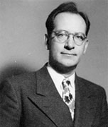
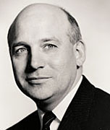
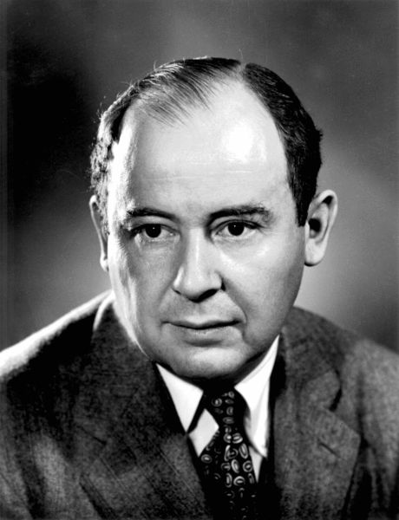
The Stored Program Computer
1944: Beginnings of EDVAC
among other improvements, includes program stored in memory
1945: John von Neumann
wrote a report on the stored program concept, known as the First Draft of a Report on EDVAC
The basic structure proposed in the draft became known as the “von Neumann machine” (or model).
a memory, containing instructions and data
a processing unit, for performing arithmetic and logical operations
a control unit, for interpreting instructions
John W. Mauchly and J. Presper Eckert, Jr.
Von Neumann

Slide 7
Outline
From ENIAC to the Stored Program Computer
A Machine Structure：von Neumann Model

Slide 8
Von Neumann Model

Slide 9
Memory
2^{k} x m array of stored bits
Address
unique (k-bit) identifier of location
Contents
m-bit value stored in location
Basic Operations:
LOAD
read a value from a memory location
STORE
write a value to a memory location
0000
0001
0010
0011
0100
0101
0110
1101
1110
1111
00101101
•
•
•
10100010

Slide 10
Interface to Memory
How does processing unit get data to/from memory?
MAR: Memory Address Register
MDR: Memory Data Register
To LOAD a location (A):
Write the address (A) into the MAR.
Send a “read” signal to the memory.
Read the data from MDR.
To STORE a value (X) to a location (A):
Write the data (X) to the MDR.
Write the address (A) into the MAR.
Send a “write” signal to the memory.

Slide 11
Processing Unit
Functional Units
ALU = Arithmetic and Logic Unit
could have many functional units. some of them special-purpose (multiply, square root, …)
LC-3 performs ADD, AND, NOT
Registers
Small, temporary storage
Operands and results of functional units
LC-3 has eight registers (R0, …, R7), each 16 bits wide
Word Size
number of bits normally processed by ALU in one instruction
also the width of registers
LC-3 is 16 bits

Slide 12
Input and Output
Devices for getting data into and out of computer memory
Each device has its own interface, usually a set of registers like the memory’s MAR and MDR
LC-3 supports keyboard (input) and monitor (output)
keyboard: data register (KBDR) and status register (KBSR)
monitor: data register (DDR) and status register (DSR)
Some devices provide both input and output
disk, network
Program that controls access to a device is usually called a driver.

Slide 13
Control Unit
Orchestrates execution of the program
Instruction Register (IR) contains the current instruction.
Program Counter (PC) contains the address of the next instruction to be executed.
Control unit:
reads an instruction from memory
the instruction’s address is in the PC
interprets the instruction, generating signals that tell the other components what to do
an instruction may take many machine cycles to complete

Slide 14
Instruction Processing
Fetch instruction from memory
Decode instruction
Evaluate address
Fetch operands from memory
Execute operation
Store result

Slide 15
Instruction
The instruction is the fundamental unit of work.
Specifies two things:
opcode: operation to be performed
operands: data/locations to be used for operation
An instruction is encoded as a sequence of bits. (Just like data!)
Often, but not always, instructions have a fixed length, such as 16 or 32 bits.
Control unit interprets instruction: generates sequence of control signals to carry out operation.
Operation is either executed completely, or not at all.
A computer’s instructions and their formats are known as its Instruction Set Architecture (ISA).

Slide 16
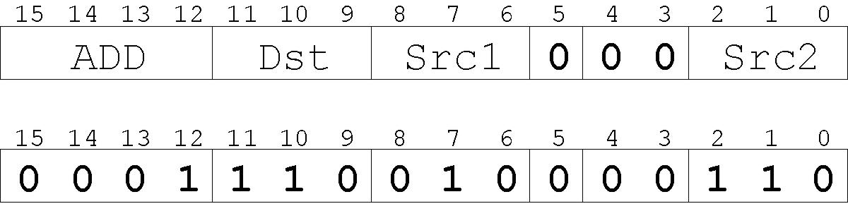
Example: LC-3 ADD Instruction
LC-3 has 16-bit instructions.
Each instruction has a four-bit opcode, bits [15:12].
LC-3 has eight registers (R0-R7) for temporary storage.
Sources and destination of ADD are registers.
“Add the contents of R2 to the contents of R6, and store the result in R6.”

Slide 17
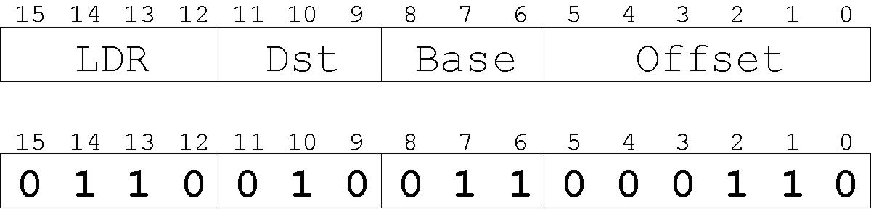
Example: LC-3 LDR Instruction
Load instruction -- reads data from memory
Base + offset mode:
add offset to base register -- result is memory address
load from memory address into destination register
“Add the value 6 to the contents of R3 to form a memory address. Load the contents of that
memory location to R2.”

Slide 18
Instruction Processing: FETCH
Load next instruction (at address stored in PC) from memory into Instruction Register (IR).
Copy contents of PC into MAR.
Send “read” signal to memory.
Copy contents of MDR into IR.
Then increment PC, so that it points to the next instruction in sequence.
PC becomes PC+1.
F
D
EA
OP
EX
S

Slide 19
Instruction Processing: DECODE
First identify the opcode.
In LC-3, this is always the first four bits of instruction.
A 4-to-16 decoder asserts a control line corresponding to the desired opcode.
Depending on opcode, identify other operands from the remaining bits.
Example:
for LDR, last six bits is offset
for ADD, last three bits is source operand #2
F
D
EA
OP
EX
S

Slide 20
Instruction Processing: EVALUATE ADDRESS
For instructions that require memory access, compute address used for access.
Examples:
add offset to base register (as in LDR)
add offset to PC
add offset to zero
F
D
EA
OP
EX
S

Slide 21
Instruction Processing: FETCH OPERANDS
Obtain source operands needed to perform operation.
Examples:
load data from memory (LDR)
read data from register file (ADD)
F
D
EA
OP
EX
S

Slide 22
Instruction Processing: EXECUTE
Perform the operation, using the source operands.
Examples:
send operands to ALU and assert ADD signal
do nothing (e.g., for loads and stores)
F
D
EA
OP
EX
S

Slide 23
Instruction Processing: STORE RESULT
Write results to destination. (register or memory)
Examples:
result of ADD is placed in destination register
result of memory load is placed in destination register
for store instruction, data is stored to memory
write address to MAR, data to MDR
assert WRITE signal to memory
F
D
EA
OP
EX
S

Slide 24
Changing the Sequence of Instructions
In the FETCH phase, we increment the Program Counter by 1.
What if we don’t want to always execute the instruction that follows this one?
examples: loop, if-then, function call
Need special instructions that change the contents of the PC.
These are called control instructions.
jumps are unconditional -- they always change the PC
branches are conditional -- they change the PC only if some condition is true (e.g., the result of an ADD is zero)

Slide 25
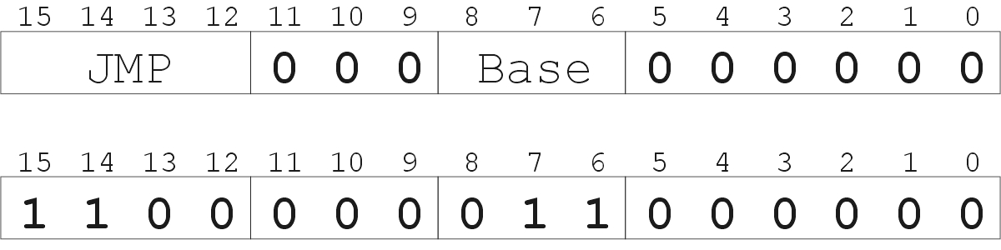
Example: LC-3 JMP Instruction
Set the PC to the value contained in a register. This becomes the address of the next instruction to fetch.
“Load the contents of R3 into the PC.”

Slide 26
Instruction Processing Summary
Instructions look just like data -- it’s all interpretation.
Three basic kinds of instructions:
computational instructions (ADD, AND, …)
data movement instructions (LD, ST, …)
control instructions (JMP, BRnz, …)
Six basic phases of instruction processing:
F → D → EA → OP → EX → S
not all phases are needed by every instruction
phases may take variable number of machine cycles

Slide 27
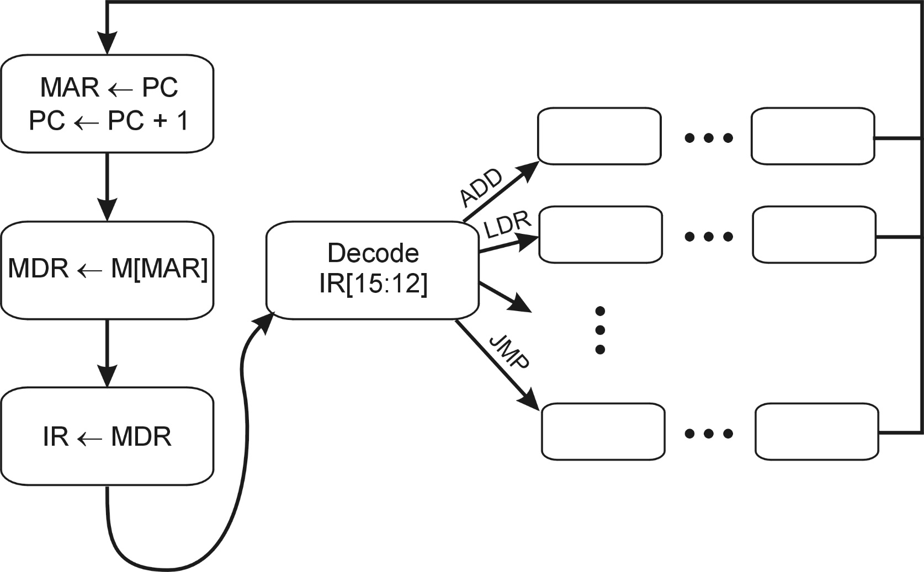
Control Unit State Diagram
The control unit is a state machine. Here is part of a simplified state diagram for the LC-3:
A more complete state diagram is in Appendix C.
It will be more understandable after Chapter 5.

Slide 28
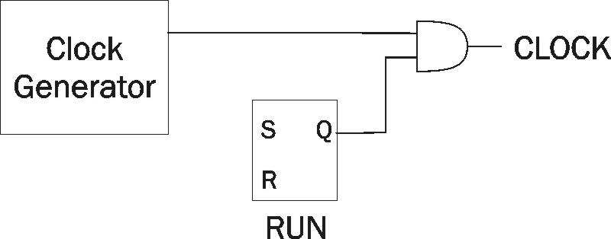
Stopping the Clock
Control unit will repeat instruction processing sequence as long as clock is running.
If not processing instructions from your application, then it is processing instructions from the Operating System (OS).
The OS is a special program that manages processor and other resources.
To stop the computer:
AND the clock generator signal with ZERO
When control unit stops seeing the CLOCK signal, it stops processing.

Slide 29
Summary: Von Neumann Model

Slide 30
Summary: Instruction Processing
Instructions look just like data -- it’s all interpretation.
Three basic kinds of instructions:
computational instructions (ADD, AND, …)
data movement instructions (LD, ST, …)
control instructions (JMP, BRnz, …)
Six basic phases of instruction processing:
not all phases are needed by every instruction
phases may take variable number of machine cycles
F
D
EA
OP
EX
S

Slide 31
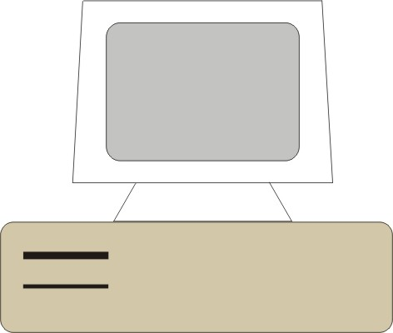
谢谢！
教师：关菲 计算机与控制工程学院

